Slide 1
CRIME DATASET ANALYSIS AND PREDICTION
-Chicago and Boston Datasets
CS6220 - Data Mining Techniques (Fall 2019)
Prajakta Rodrigues, Samarth Parikh, Sangeetha Chandrashekar, Tej Bhavsar

Slide 2
Topics
Introduction
Methodology
Future Work
Results and Conclusion
References

Slide 3
INTRODUCTION
Notes:
Prajakta

Slide 4
Why crime data analysis?
Crime has existed since the early days of civilization and has steadily found its ground in every part of the world.
Criminals have started manipulating advancements in technology as a means to their end.
To minimize and negate advancement in crime, powerful tools such as data mining can shed light on crime patterns as well as aid authorities to be a step ahead in managing crime.
Hundreds of crimes recorded daily by the data officers working alongside law enforcement authorities throughout USA
To identify the patterns in crime and recognize the threats which would help citizens to be more self aware
Data mining techniques will complement the authorities in understanding different crimes and help in crime prevention
To identify areas with high crime rates in Chicago and Boston which would help for better crime management
Use the solutions to help reduce the crime rate in other cities facing similar issues
Notes:
Prajakta

Slide 5
Problem Statement
Perform exploratory analysis of the Chicago crime dataset to mine patterns of crimes and understand trends
Perform exploratory analysis of the Boston crime dataset and use it for generic comparison with the patterns observed in the Chicago dataset
Apply data mining methods like classification and time series model to recognize the crime types and patterns utilizing the given features
Apply association mining to identify associations between features
Create a forecast tool to help police authorities understand the crime trends of the future to plan preventive measures
Notes:
Prajakta

Slide 6
Dataset
We are utilizing the ‘Crimes in Chicago’ dataset for this project. This dataset reflects reported incidents of crime that occurred in the City of Chicago from 2001 to 2019. Its features consist of information on Crime type, Case number, Location, Latitude, Longitude, whether it is domestic or not etc. The dataset is availed from - https://catalog.data.gov/dataset/crimes-2001-to-present-398a4
Apart from this we have utilized ‘Crimes in Boston’ dataset to compare general crime trends between Chicago and Boston. This dataset is comparable to the dataset of crimes in Chicago. Boston crime dataset is availed from - https://www.kaggle.com/AnalyzeBoston/crimes-in-boston
Notes:
Prajakta
Chicago dataset has data of crimes from 2001 to 2019 and provides much more information than the Boston dataset which only has data from 2015 to 2018

Slide 7
Data description
Chicago Dataset Features
ID | Case Number | Date | Block | IUCR | Primary Type | Description | Location Description
Arrest | Domestic | Beat | District | Ward | Community Area | FBI Code | X Coordinate
Y Coordinate | Year | Updated On | Latitude | Longitude | Location
Notes:
Prajakta
Before cleaning the number of entries in chicago dataset were 7 million
Before cleaning the number of entries in boston dataset was 2.6 lac

Slide 8
Data description
Boston Dataset Features
INCIDENT_NUMBER | OFFENSE_CODE | OFFENSE_CODE_GROUP | YEAR | SHOOTING
REPORTING_AREA | DISTRICT | OFFENSE_DESCRIPTION | HOUR | LOCATION
OCCURRED_ON_DATE | DAY_OF_WEEK | UCR_PART | MONTH | STREET
Notes:
Prajakta

Slide 9
METHODOLOGY

Slide 10
Libraries Used and Code
We have extensively used panda, numpy, sklearn libraries provided by python for all stages of our data mining process.
We used matplotlib to plot our charts and graphs to visualize the data and the explored patterns. Seaborn library was used to generate heatmaps.
We used Decision trees algorithm, Random Forest algorithm for classification.
The fbprophet library provided by Facebook open source was used for time-series forecast and understanding trends throughout the years
Other libraries that have been utilized are sklearn for metrics and other methods, mlxtend for apriori algorithm.
The entire project code can be found in the below GitHub link : https://github.ccs.neu.edu/sangeethac/CS6220-DMT-Project
Notes:
Sangeetha

Slide 11
Data Preprocessing
Method of preparing the data for analysis and prediction is known as data preprocessing
Important because the raw data is generally incomplete, noisy, repetitive and inconsistent
Data cleaning: To remove any invalid or null values that could affect the data analysis
Data reduction: To discard some of the features that do not add value to the data analysis
For example: Beat, Domestic, FBI code, Updated on etc.
Data Transformation: To transform values of certain features for better analysis
Values of “Arrest” feature can be transformed to 0 or 1 from true or false
Encoding the multiclass label to fit them in classification algorithms
Notes:
Sangeetha

Slide 12
Exploratory Data Analysis of Chicago
Notes:
Prajakta

Slide 13
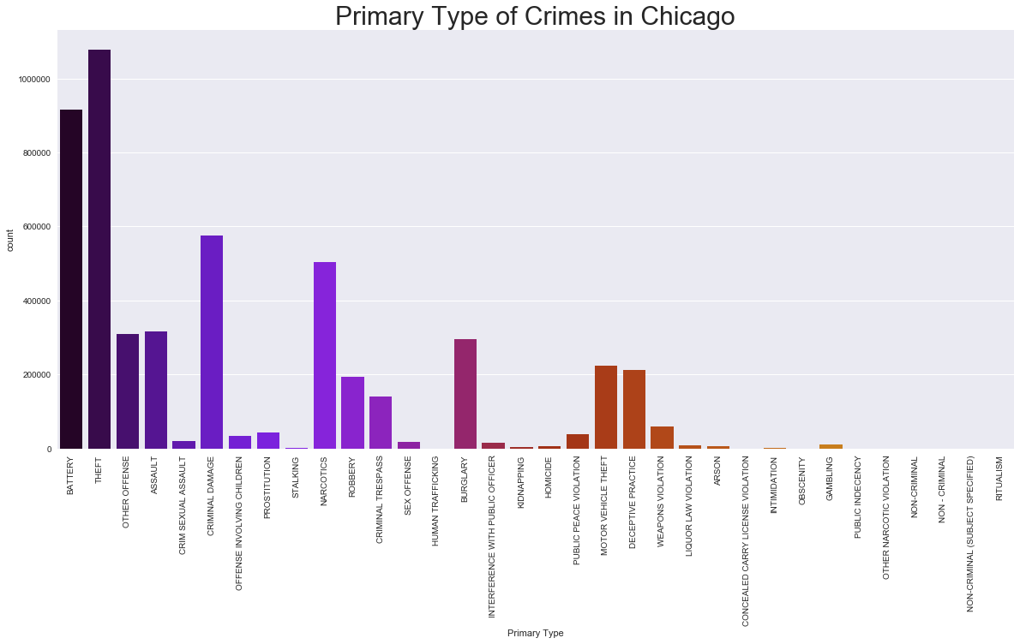
Primary Types of Crimes
Notes:
Prajakta
There are 33 different Primary Types i.e. crime types in the chicago dataset.
The top crime is theft, battery and criminal damage.

Slide 14
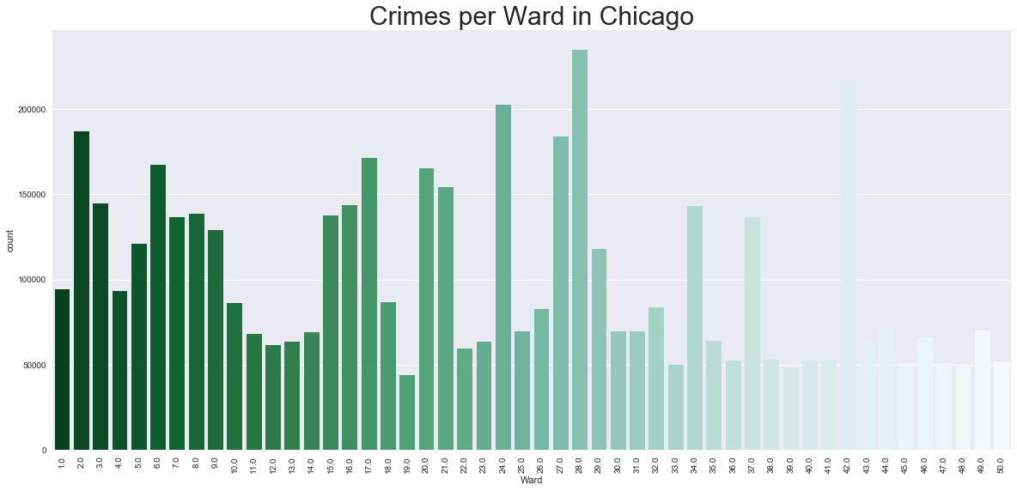
Crimes according to Wards
Notes:
Prajakta
The wards 28, 24 and 2 have highest number of crimes.

Slide 15
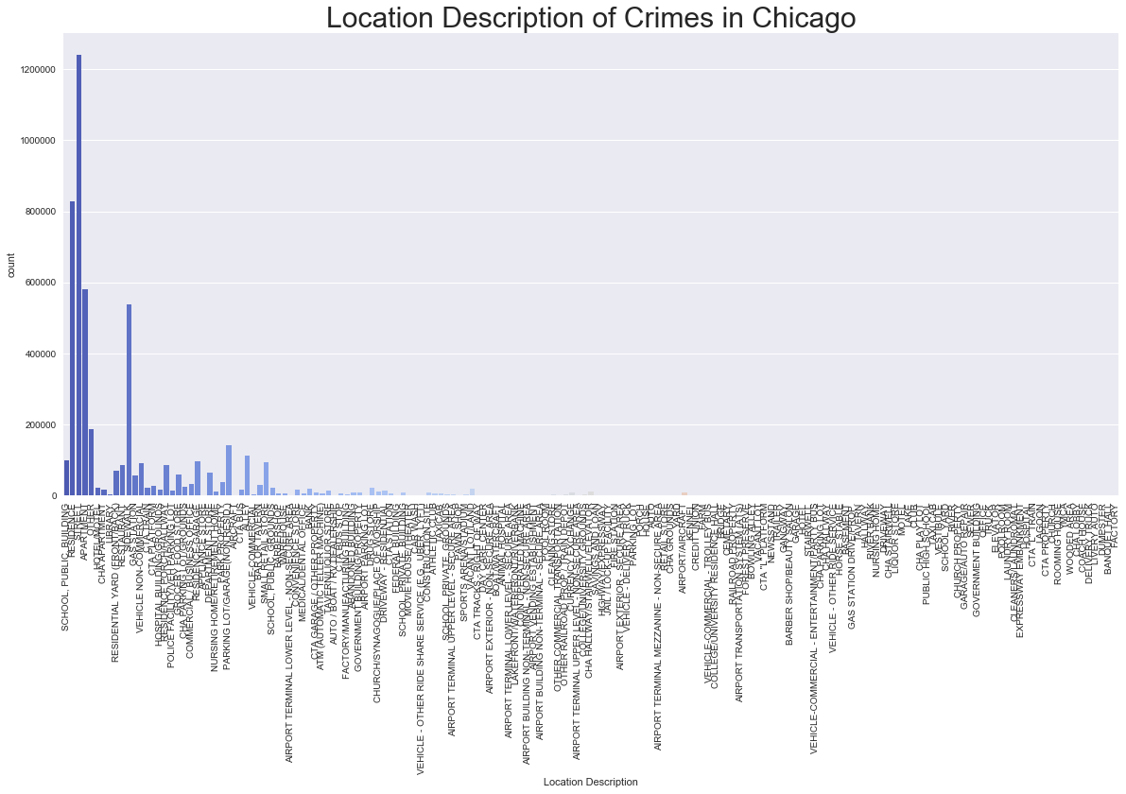
Location Description of Crimes
Notes:
Prajakta
Some locations are prone to high crime rate while other aren’t.
Based on location, when we plot the number of crimes, the location having highest number of crimes is street, residence and apartments.

Slide 16
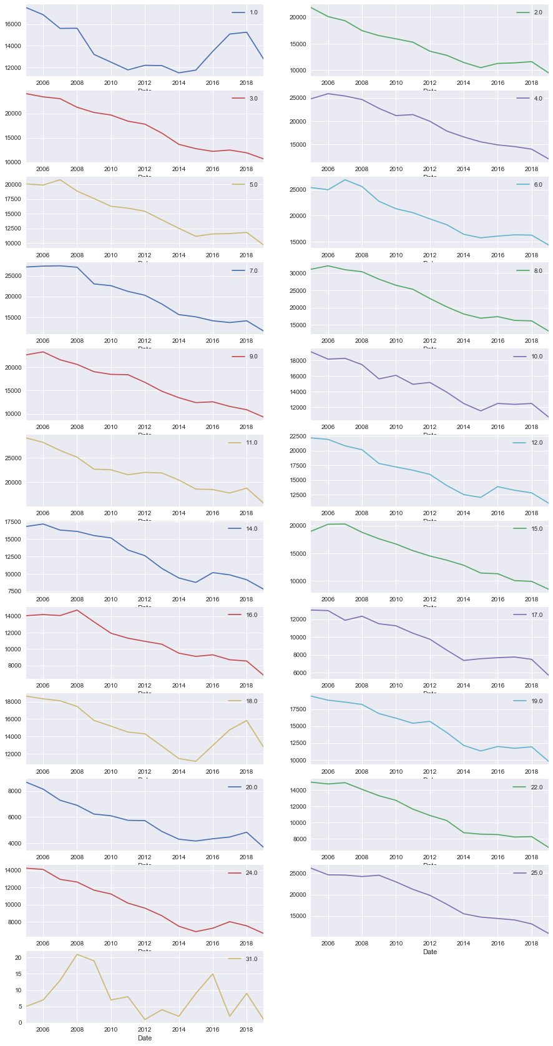
District of Crimes
Crime trends throughout the years plotted for some districts of Chicago.
Notes:
Prajakta
There are 31 districts in Chicago
The above graph shows the way crime has progresses through the years for each district.
As, you can see the rate has been going down through the years mostly except an occassional spike

Slide 17
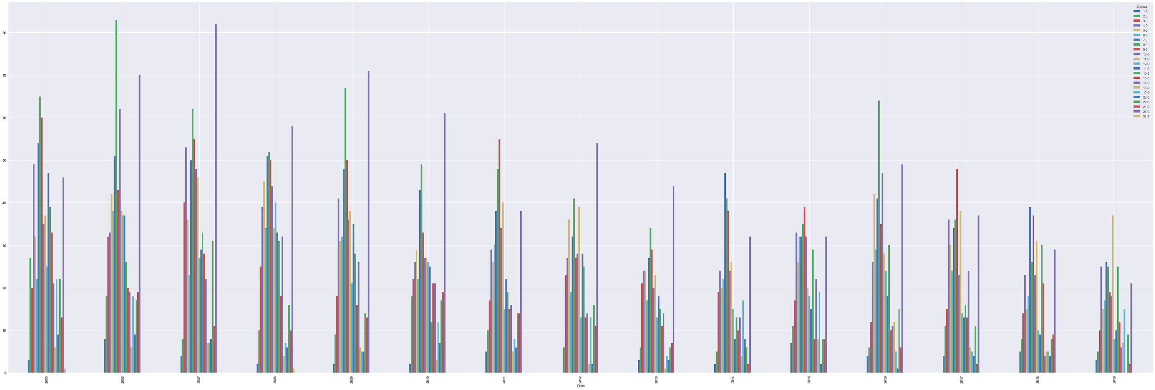
Top violent crime - Arson
Top violent crime identified plotted against different districts through the years
Notes:
Prajakta
We have identified top five violent crimes for Chicago and plotted their data for analysis per district throughout the years. The graph shows rates of crimes involving arson which is the top violent crime plotted for each district.

Slide 18
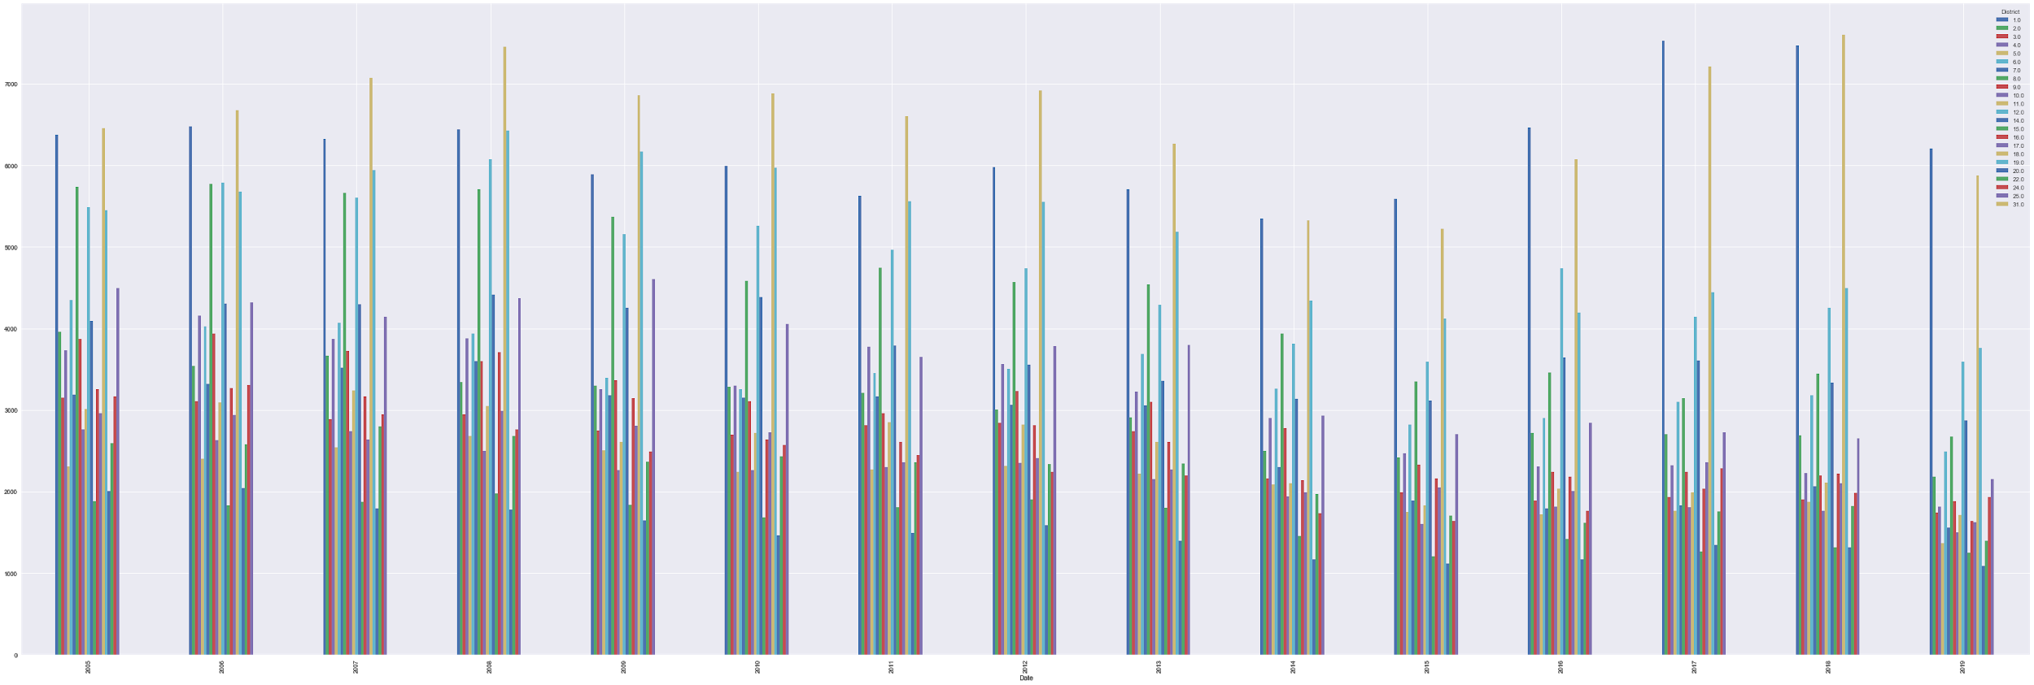
Top Non-Violent crime - Theft
Top non-violent violent crime identified plotted against different districts through the years
Notes:
Prajakta
We have identified top five non-violent crimes for Chicago and plotted their data for analysis per district throughout the years. The graph shows rates of crimes involving theft which is the top non-violent crime plotted for each district.

Slide 19
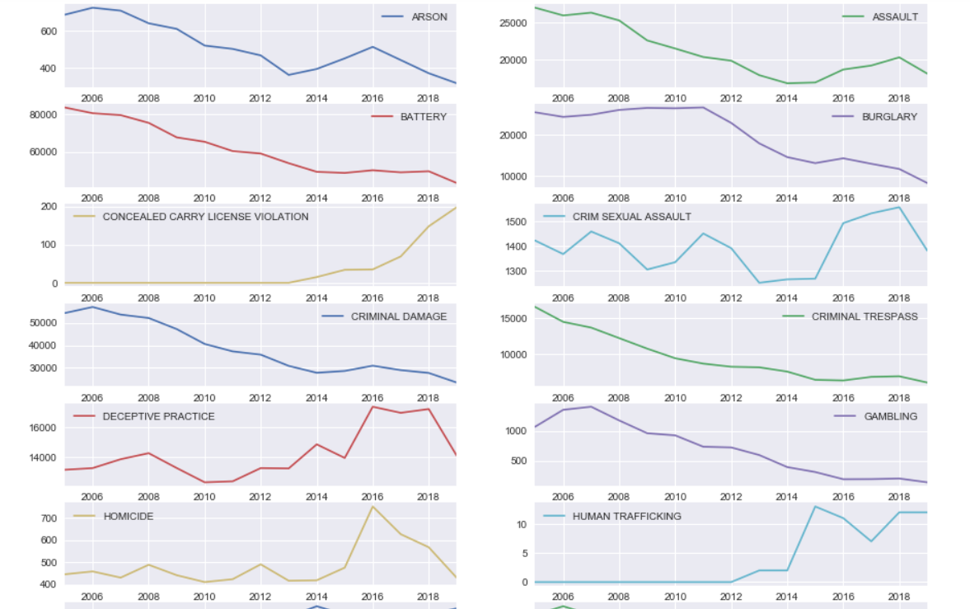
Crime Types
Crime trends throughout the years plotted by 34 types of crimes in Chicago.
Notes:
Sangeetha

Slide 20
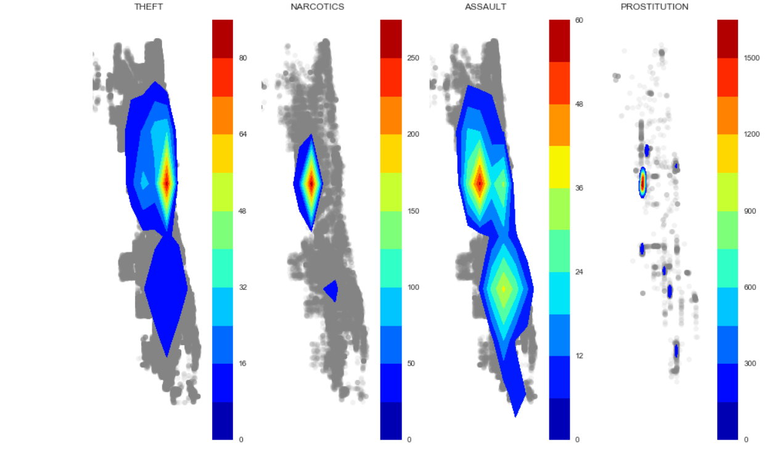
Location Heatmap of Crimes
Heatmap based on different crime types plotted using the X and Y coordinates provided in each of the reported crime
Notes:
Sangeetha: Based on the given crimes latitude and longitude, the above heatmap has been generated. The heatmap depicts the locations in Chicago

Slide 21
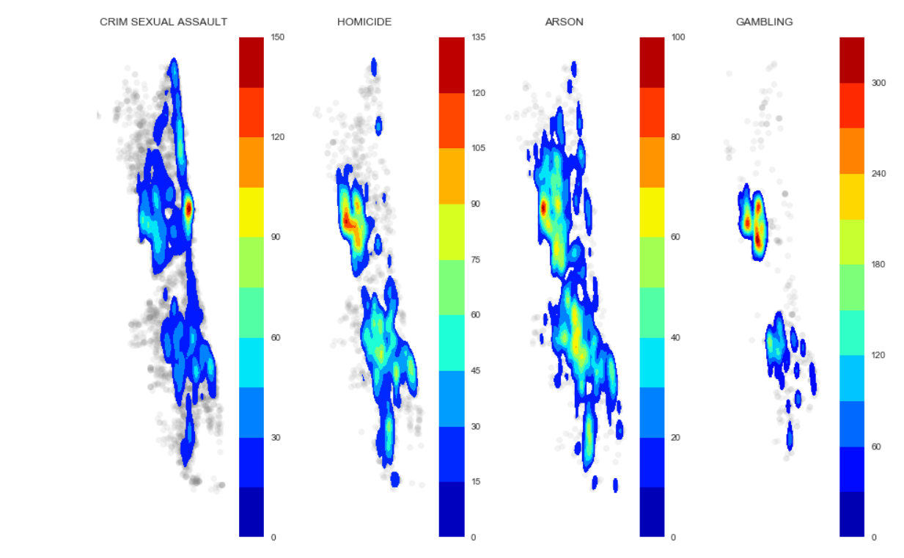
Location Heatmap of Crimes contd.
Notes:
Sangeetha

Slide 22
Exploratory Data Analysis of Boston
Notes:
Samarth

Slide 23
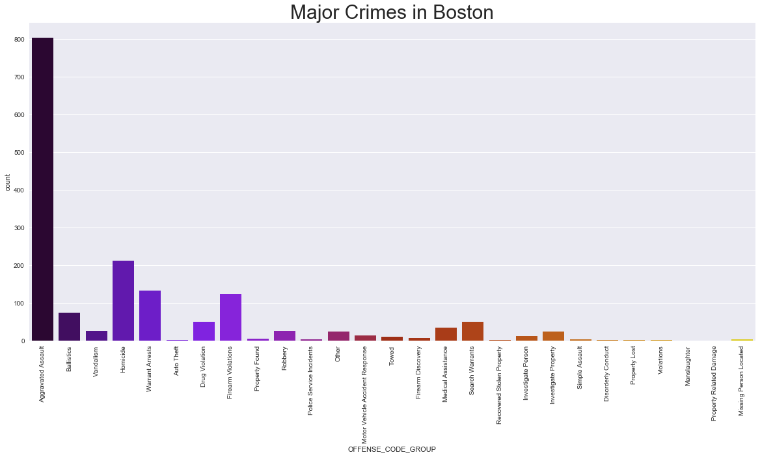
Major crimes
There are 27 different crime types in the Boston dataset and as it is evident from the image ‘Aggravated Assault’ is the most occurred crime type.
Notes:
Samarth

Slide 24
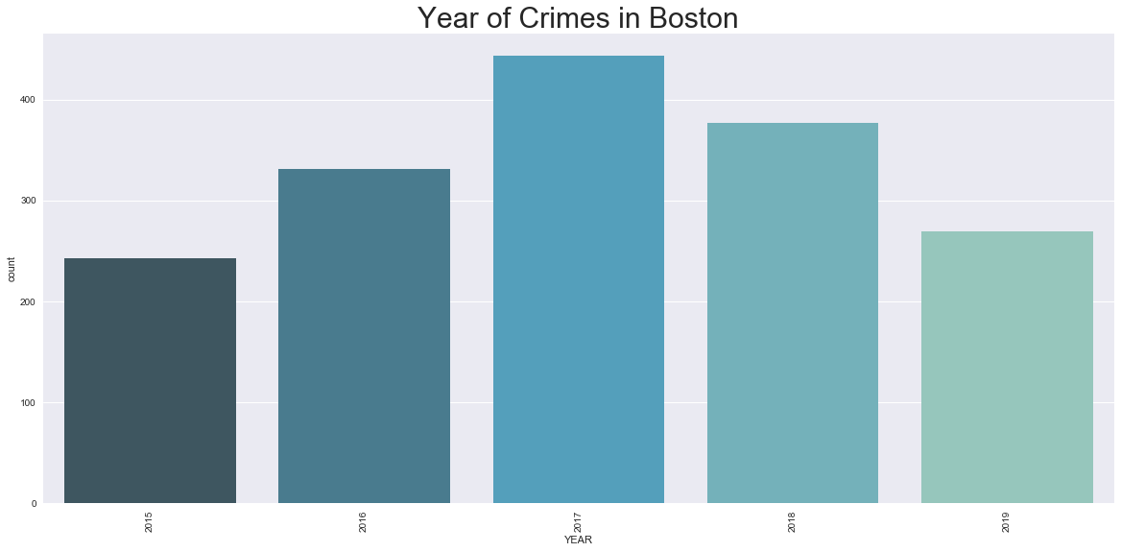
Crime Count Per Year
Notes:
Samarth

Slide 25
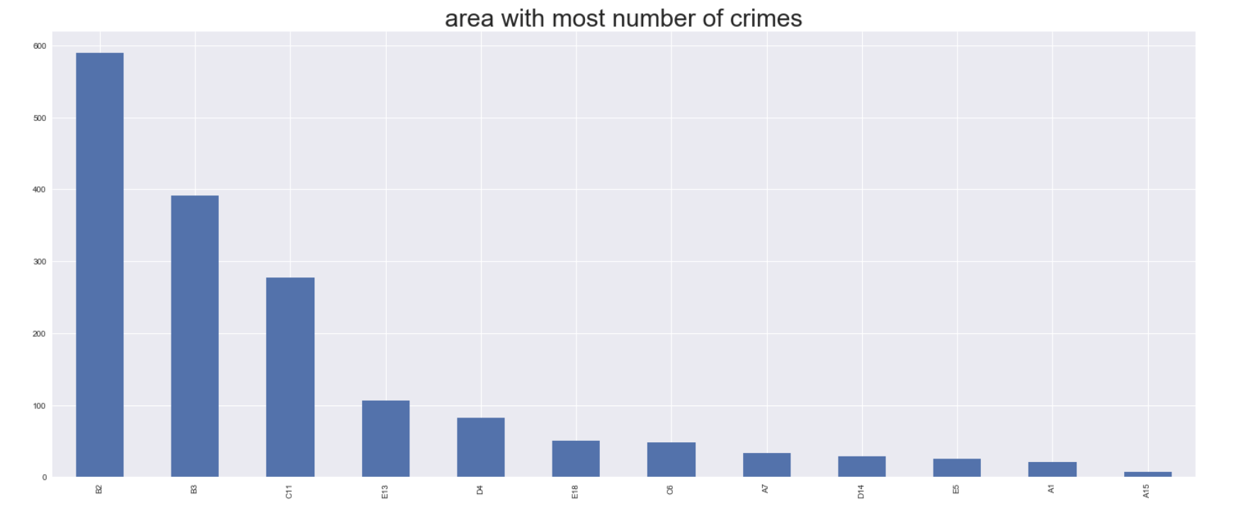
Crime analysis according to area
Notes:
Tej - x-axis: Area in form of the district code, y-axis: number of crimes. B2 district is the least safe with 590 crimes over the period of 5 years while A15 is the safest district with around 10 crime reports.

Slide 26
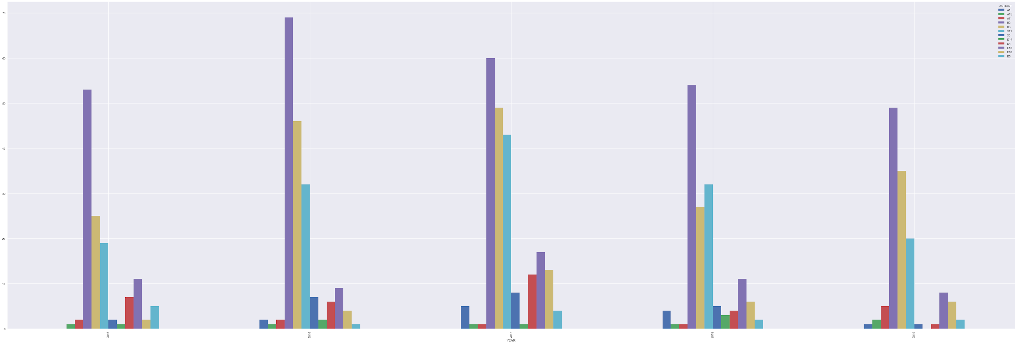
Aggravated Assault throughout the years in various districts
Notes:
Tej - number of A.A. occurred in different districts over the years. District B2 has maximum number of Aggravated assaults over the years (with a peak of 68 occurrences in the year 2016).

Slide 27
Classification techniques
Notes:
Sangeetha

Slide 28
Classification
Classification technique is an important and widely used data mining process that enhances the understanding and prediction of classes based of the dataset
Classification is the procedure to fit a set of training data into the classification algorithm to generate relations and understanding the different categories the given dataset falls under. This understanding is extended to a testing data to predict the classes/labels that the test dataset belongs to.
Classification helps data analysts to generate the class/category for a set of features that have not been categorized yet.
Classification also helps in understanding the influence of various features on the classes.
Decision Trees and Random Forest are popular supervised learning algorithms used for classification. They are considered to generate better predictions as compared to probabilistic fitting models like Naive Bayes.
Notes:
Sangeetha

Slide 29
Classification contd.
Chicago Dataset
As a part of our data analysis and mining, we ran our dataset through two different classification algorithms, Random Forest and Decision Trees to solve the below problem.
“Given a data that belongs to a partial feature set, can we predict the type of crime?”
The features used for applying classification algorithm are Description, Location coordinates, Arrest, Domestic, Ward, District, Year
The class label to be predicted are the different Primary Type.
The result found through various experiments and application of combinations of data features, we found that Random Forest applied for feature set without IUCR feature gives the best prediction results with accuracy ~93%. Although Random Forest eliminates the issue of overfitting by consulting multiple Decision Trees to classify a given data, removing IUCR ensures that the algorithm is not subjected to inadvertent overfitting.
The accuracy obtained from Decision Tree classification is ~68%.
Notes:
Sangeetha

Slide 30
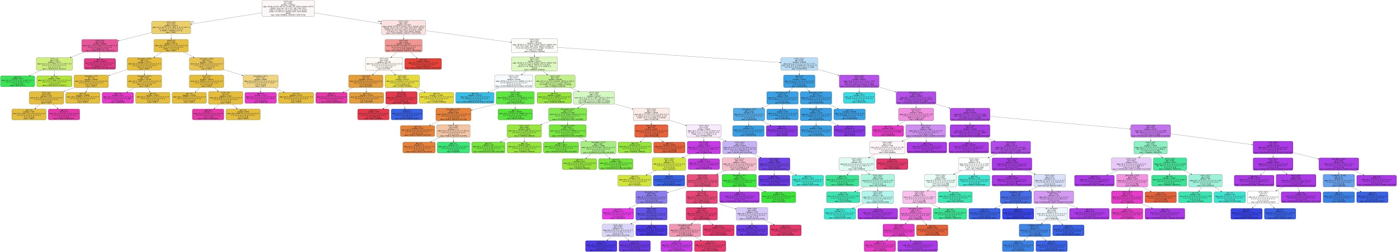
Classification contd.
Chicago Dataset
Decision Tree obtained for Chicago dataset for classification of crime types
Notes:
Sangeetha

Slide 31
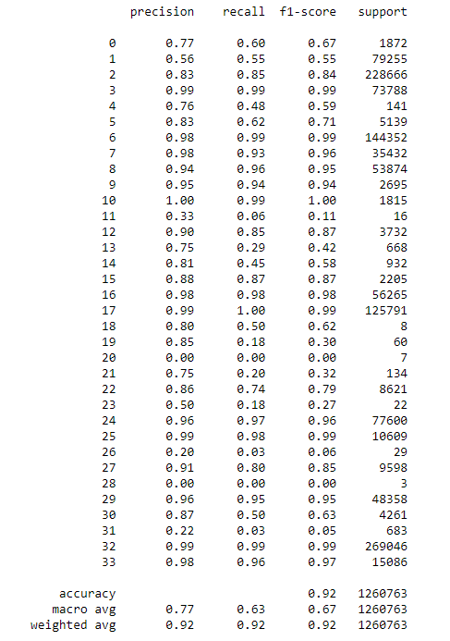
Metrics: Classification Report
The metrics is an effective mathematical calculation to evaluate the results from the classifiers.
We see here a classification report consisting of various metrics for Random Forest classification.
The Accuracy is ~92% which is the best result obtained from the different variations of features applied.
The accuracy obtained from previous decision tree is ~68% and the result cannot be relied due to the overfitting issue.
Other detailed reports can be found in the code.
Notes:
Sangeetha

Slide 32
Classification
Boston Dataset
As a part of our data analysis and mining, we ran our dataset through the Random Forest classification algorithm
The features used for applying classification algorithm are Description, District, Reporting area, Shooting, Date, UCR Part
The class label to be predicted are the different Offense Code Groups(i.e. Crime types).
The result found through various experiments and application of combinations of data features, we found that Random Forest applied for feature set without Offense code feature gives the best prediction results with accuracy ~95%.
Notes:
Tej

Slide 33
Association mining
Notes:
Prajakta

Slide 34
Association Mining
Association Mining helps find patterns in data by finding the features that occur together and features that are correlated .
Association mining is often applied to dataset that have binary values in predictive columns. A popular example for associating mining is Market-Basket analysis.
Apriori is an influential algorithm that helps in mining association rules and identify frequent itemsets.
In order to apply Apriori Algorithm, we performed data cleaning and preprocessing activities to make each entry similar to basket and each data entry similar to item.
As apriori has high memory requirements we separated the dataset by year and analyzed recent years viz. 2019, 2015 and 2011
Notes:
Prajakta
There are various techniques that we used to mine rules from the dataset like dropping dependent columns, map values from column to have separate identity to be considered as a unique item in an itemset.

Slide 35
Association Mining contd.
Few of the association rules observed for Chicago dataset are as follows:
(no arrest, Not Domestic) -> (Primary Type THEFT) So, in most case when the crimes is not domestic and no arrest there is high confidence that the crime was theft
(Location Description STREET) -> (no arrest) So, in case the location of the crime was on the street, the confidence that no arrest was made is high.
(no arrest) -> (Community Area 24.0) There is high confidence that if an arrest wasn’t made, the community area in which the crime occured is 24
(Time Period 13) -> (no arrest) Many crimes occur during time period 13 and there is high confidence that no arrest will be made
(Primary Type BATTERY) -> (no arrest) Crimes with type battery have very high confidence of no arrest
Notes:
Prajakta

Slide 36
Time series model
Notes:
Sangeetha

Slide 37
Time Series Model
To solve the problem we set out with, we needed to help the authorities understand what trend they could expect in the near future. This led us to Prophet, an open source time series model designed by data analysts at Facebook.
Prophet uses long term increase or decrease in data, applies Fourier series to understand the seasonal trends and also considers holiday and large events impacting the data series.
We fit Chicago and Boston dataset in Prophet model and we observed the results as shown here. The result was later extend to be applied to five different violent and five non-violent crimes to individually analyse them. These extended forecast models can be obtained from our code file.
The results observed give us an insight into the crime patterns for the year 2020. We can also see the weekly, monthly trends as well for the officials to be better prepared with preventive measures during the peak crime days.
The root mean squared error for prophet model in our dataset is 88.43
Notes:
Sangeetha

Slide 38
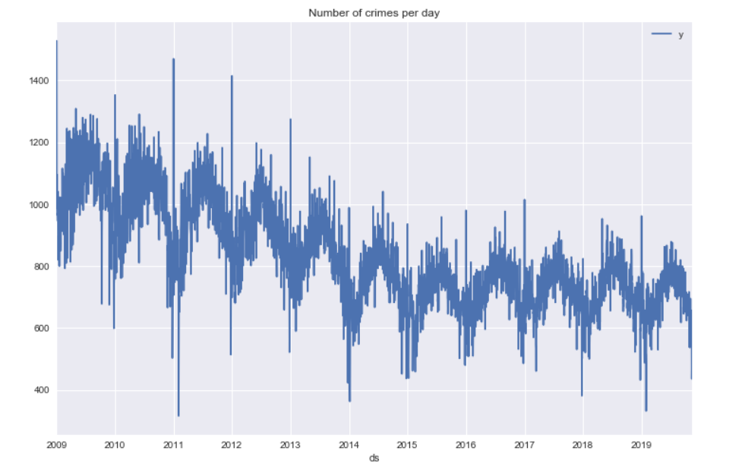
Crime trends 2009-2019
Chicago Dataset
Below is the time graph plotted using all the crimes reported from 2009-2019
Notes:
Sangeetha

Slide 39
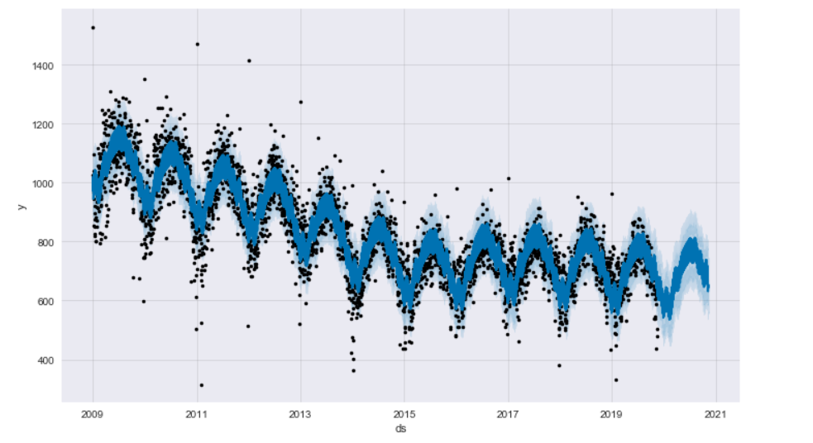
Prophet Forecast Results
Chicago Dataset
Forecast of the crime trend in 2020 can be seen by the dark blue line below
Notes:
Sangeetha

Slide 40
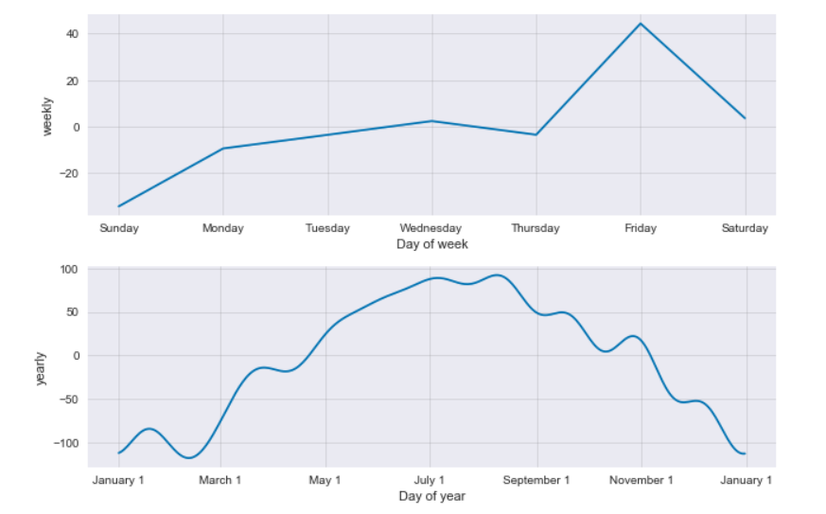
Prophet Forecast Results contd.
Chicago Dataset
Time graph showing the weekly and monthly trend for the forecast year 2020
Notes:
Sangeetha

Slide 41
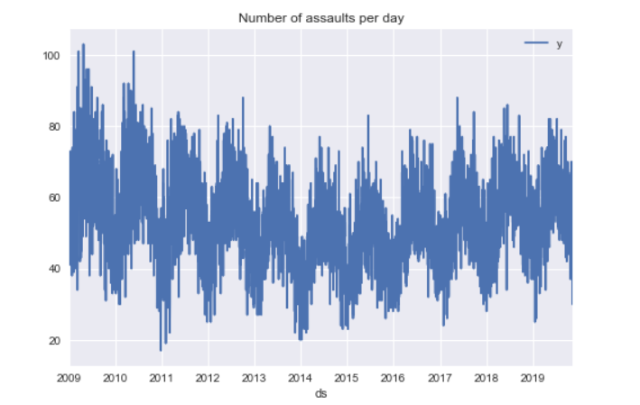
Time serie model for Assault
Chicago Dataset
Notes:
Sangeetha

Slide 42
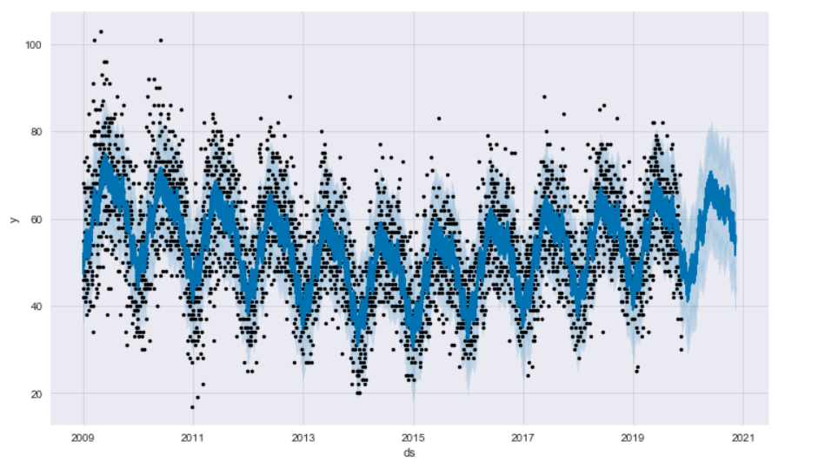
Prophet Forecast Results for Assault
Chicago Dataset
Notes:
Sangeetha

Slide 43
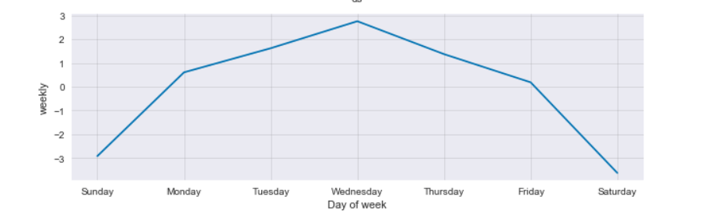
Daily Prophet Forecast Results for Assault
Chicago Dataset
Notes:
Sangeetha

Slide 44
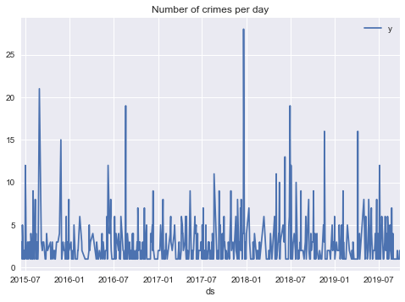
Crime trends 2015-2019
Boston Dataset
Notes:
Samarth

Slide 45
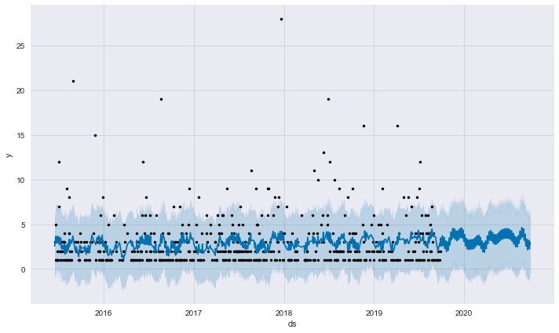
Prophet Forecast Results
Boston Dataset
Forecast of the crime trend in 2020 can be seen by the dark blue line below
Notes:
Samarth

Slide 46
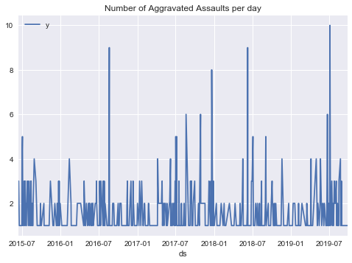
Time series of the Aggravated Assault.
Boston Dataset
Notes:
Tej

Slide 47
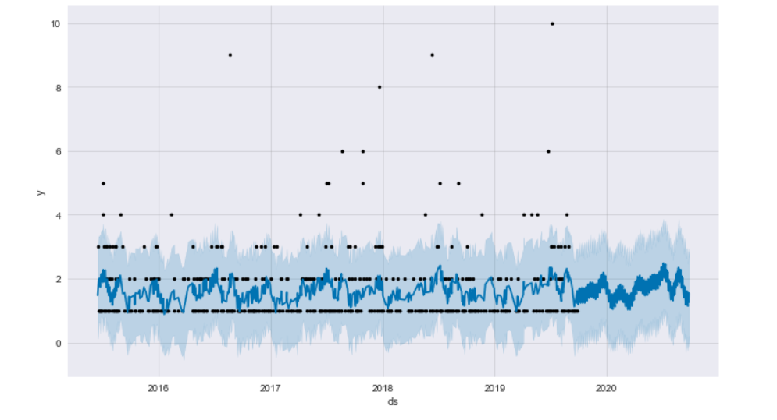
Prophet Forecast Results for Assault
Boston Dataset
Notes:
Tej - We can see a prediction for number of aggravated assaults for the 2020 year. Dark blue lines represent the forecast value.

Slide 48
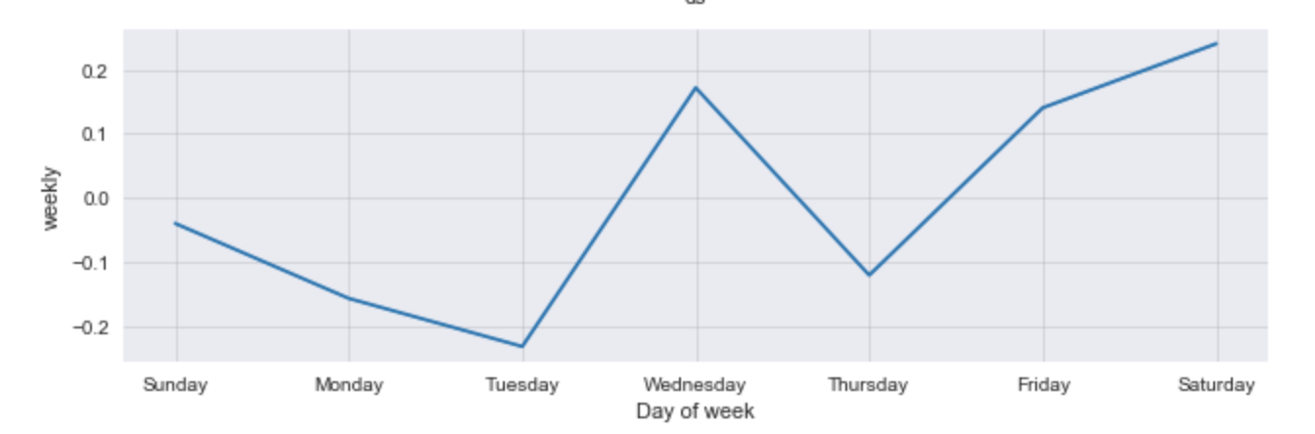
Daily Prophet Forecast Results for Assault
Boston Dataset
Notes:
Tej - Wednesday, Friday and Saturday experience a large number of crimes as compared to other days. Whereas Tuesday has the least number of crimes reported.

Slide 49
FUTURE WORK

Slide 50
Future Work
As a part of the future work, we believe the time series forecast can be added to every beat inside a police district so that the preventive measures can be applied at the lowest level of the authorities to improve and increase the chances of reducing and handling the control of crime.
We can also perform data analysis and reveal more trends and patterns by combining a dataset of household income per community area to understand how the crime affects the richer communities as compared to the poorer communities.
We can also combine the crime dataset with the education levels and job opportunities dataset to understand the mindset of the criminals and perpetrators.
Notes:
Tej

Slide 51
RESULTS AND CONCLUSION

Slide 52
Final Results and Conclusion
In the previous slides we have seen the application of classification and time series model on the Chicago and Boston Dataset. The metrics for both the classification and prophet model have revealed that the results obtained for the final models are almost ideal and have the least error margin compared to other initial models we used.
In order to satisfy our goal and achieve a solution for our problem statement of providing a analysis and predicting the crime trends for future to help the authorities plan preventive measures, we extended the time series prediction to forecast the trend for year 2020 for every crime type in every polica district. In the next slide, we will see the crime trends of Homicide for police district 1.0 as a glimpse of the result obtained. The complete time graphs with forecast for every crime in every district of Chicago and Boston is available in the code file. (230 forecasts for Chicago and 165 forecasts for Boston)
Hence we successfully completed our goal to bring about analysis and prediction to help officials take preventive measures .
Notes:
Samarth

Slide 53
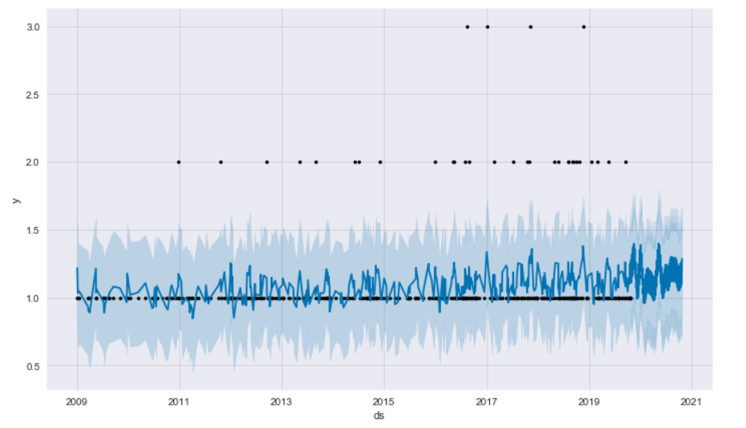
Results contd.
Crime forecast of Homicide in police district 1.0
Notes:
Samarth

Slide 54
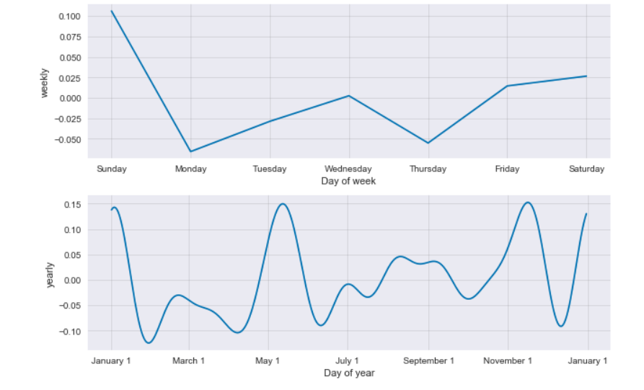
Results contd.
Crime forecast of Homicide in police district 1.0 - weekly and monthly
Notes:
Samarth

Slide 55
REFERENCES

Slide 56
References
[1] Louppe, Gilles. (2014). Understanding Random Forests: From Theory to Practice. 10.13140/2.1.1570.5928.
[2] Taylor SJ, Letham B. 2017. Forecasting at scale. PeerJ Preprints 5:e3190v2
[3] Feng, Mingchen & Zheng, Jiangbin & Ren, Jinchang & Hussain, Amir & Li, Xiuxiu & Xi, Yue & Liu, Qiaoyuan. (2019). Big Data Analytics and Mining for Effective Visualization and Trends Forecasting of Crime Data. IEEE Access. PP. 1-1. 10.1109/ACCESS.2019.2930410.
[4] M. Feng et al., "Big Data Analytics and Mining for Effective Visualization and Trends Forecasting of Crime Data," in IEEE Access, vol. 7, pp. 106111-106123, 2019. doi: 10.1109/ACCESS.2019.2930410
[5] Pradhan, Isha, "Exploratory Data Analysis And Crime Prediction In San Francisco" (2018). Master's Projects. 642.
[6] Tong Wang, Cynthia Rudin, Daniel Wagner, and Rich Sevieri. 2013. Detecting patterns of crime with series finder. In Proceedings of the 17th AAAI Conference on Late-Breaking Developments in the Field of Artificial Intelligence (AAAIWS'13-17). AAAI Press 140-142.
[7] Pang-Ning Tan, Michael Steinbach, Anuj Karpatne, Vipin Kumar. Introduction to Data Mining (Second Edition)
[8] Craig Silverstein, Sergey Brin, Rajeev Motwani. Beyond Market Baskets: Generalizing Association Rules to Dependence Rules.1998 Kluwer Academic Publishers, Boston

Slide 57
Thank you!

